Slide 1

Implementing Geosemantics
@ IFGI, 52°North
Patrick Maué
Institute for Geoinformatics (IFGI)
pajoma@uni-muenster.de
Notes:
Name and Status,
Background,
Title: Web Services in the Geosaptial Semantic Web:
I will introduce you in the wonderful world of geographic information science, and the current state of the geospatial web. The problem is: it is a world without w3c standards, no wsdl , no soap , no fortunately no uddi.

Slide 2
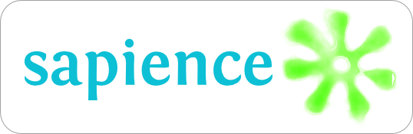
Semantic Annotations API
http://purl.org/net/sapience/docs
Lightweight Java API supporting the dynamic and standard- compliant injection of references to external shared vocabularies.

Slide 3
Semantic Annotations Wrap Up
Semantic annotations
real world associations between (meta)data and shared vocabularies (addressable via URIs)
Semantic annotations in OGC Standards
Discussion Paper OGC 08-167r1
  Best Practice Solutions to add references to existing standards (GML Schema, GML, KML, SensorML, OWS Common, …)
  focus on compliance (re-using existing features in standards)

Slide 4
Examples
KML
<placemark>
<name> some river </name>
<ExtendedData>
<Data name="urn: … modelReference">
<value>http://sws.geonames.org/3020251/about.rdf</value>
</Data>
</ExtendedData>
<Point> ....
GML
<om:Observation>
<om:observedProperty
xlink:href=”urn:ogc:def:phenomenon:WaterStage”>
<om:Procedure
xlink:href=”http://.../rdf/Gauge04”
xlink:arcrole=”urn:...:modelReference”>
...
GML Schema
<element name=”rivers”
type =”RiverType”
sawsdl:modelReference=”http://.../rdf/River”>
<complexType name=”banksType”>
…

Slide 5
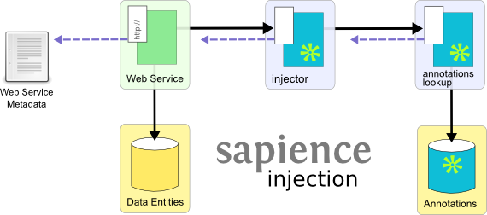
Injecting external references into metadata

Slide 6
Status & Outlook
Implementation ongoing
Integration with deegree Framework (GDI-Grid Project)
  Running version planned for February 2010
  Focus on WSDL/WSRF (Grid context)
What is needed
  Feedback on best practices (Wiki space)
  URNs for references (domainReference, gazetteerReference, modelReference, ...?)

Slide 7


Concept Repository
http://purl.org/net/sapience/docs
http://purl.org/net/concepts/
Moving from an ontology repository to the more fine-grained and context-sensitive concept repository.

Slide 8
Background
Ontology engineering tasks in projects Swing and GDI-Grid
Ontology Repositories should support
  fine-grained access to the models
  filter mechanisms to select relevant concepts only
  context-aware access methods
  ontology evolution (and access to prior versions)
  Consistency checks for relations
Implementing“Best Practice Recipes for Publishing RDF Vocabularies” (W3C, http://www.w3.org/TR/swbp-vocab-pub/)

Slide 9
Identifying concept descriptions
URL representing the concept identifier
  http://.../rdf/River
  http://.../rdf/subject/Transportation/River
  http://.../rdf/River&subject=Transportation
  http://.../rdf/River_Transportation
→ last three are equivalent and return a (domain dependent) description of the concept River

Slide 10
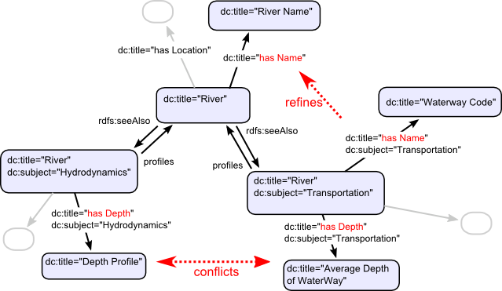
Concept Profiling

Slide 11
Query Actions (supporting selection)
http://.../rdf/describe?title=River
  see also: http://.../rdf/River
http://.../rdf/all?subject=Transportation
  see also: http://.../rdf/subject/Transportation/
http://.../rdf/neighbors?title=River&subject=Transportation
→ keywords trigger SPARQL queries
(support for custom actions)

Slide 12

Spatial Built-ins for SWRL
Supporting spatial analysis and topology
tests within the ontologies.

Slide 13
Set of boolean and arithmetic topological operators
name(?param,...)
equals
disjoint
contains
overlaps
Derived operations (touches, within, crosses,...)
name(?param,.., ?result)
Boundary
Distance
Area,Length,Perimeter
MBR,ConvexHull
Buffer
Intersection,Union,Difference
...
Inspired by OGC Simple Features Access (06-103r3), GeoSPARQL (09-157),

Slide 14
SWRL Spatial examples
Set a river as navigable for my ship if its depth exceeds 5 meter.
  River(?river) ^ hasDepth(?river,?depth) ^ swrlb:greaterThan(?depth,5)
  → isNavigable(?river,true)
Select all roads which cross the river Rhine
  hasGeometry(Rhine,?river_geom) ^ Road(?road) ^ hasGeometry(?road,?road_geom) ^ swrls:crosses(?river_geom,?road_geom)
  → sqwrl:select(??road)

Slide 15
SWRL Spatial examples (con'd)
Identify potential flood risk for buildings.
  River(?river) ^ Building(?building) … swrls:buffer(?river_geom, ?result, 100) ^ swrls:contains(?result,?building_geom)
  → RiskedBuilding(?building)
Query OpenStreetMap to populate ontology with river features.
  osm:query(“http:..”) ^ OSM_Feature(?x) ^ hasTag(?x, “River”)
  → River(?x)
Query WFS and compute convex hull of the resulting feature collection
  ogc:query-wfs(“http://...”, ?filter, ?query-result) ^ swrls:convexHull(?query-result, ?hull) ^ ...

Slide 16
SWRL Issues
Scalability difficult
(work on feature collections if possible)
Reasoner support could be improved
(Jess, IRIS, PELLET,...)
Source Code (querying SOS and OSM, implemented built-in for contains) available in 52°N repository
Alignment with GeoSPARQL

Slide 17
Wrapping Up
Documentation of Sapience and Core (and these slides)
http://purl.org/net/sapience/docs
Documentation of SWRL Spatial (in the making)
http://52north.org/twiki/bin/view/Semantics/SwrlSpatial
Thanks.
Patrick Maué
pajoma@uni-muenster.de

Slide 18
Idea: Rebuilding OGC Simple Features
ogc:FeatureAttribute
Is a
ogc:Feature
hasFeatureAttribute
ogc:Geometry
Is a
Point
LineString
...

Slide 19
Status & Outlook

Slide 20
Conclusion
Where to download these slides
Links to the three projects

Slide 21
SWRL (OWL) vs. SPARQL (RDF) remove
RiverFeature rdf:type owl:Class
owl:subConceptOf ogc:Feature
hasGeometry rdf:Type owl:ObjectProperty
rdfs:hasDomain ogc:Feature
rdfs:hasRange ogc:Geometry
hasDepth rdf:type owl:ObjectProperty
rdfs:hasDomain RiverFeature
rdfs:hasRange xsd:String
ogc:Feature
Geometry
RiverFeature
RiverFeature
AverageDepth
SELECT ?y
WHERE {
?x rdf:type RiverFeature.
?y hasDomain ?x ;
hasRange AverageDepth.
...
}
River(?x) ^ hasDepth(?x,?y) ^
swrlb:greaterThan(?y,5)
→ sqwrl:select(?x)

